Slide 1


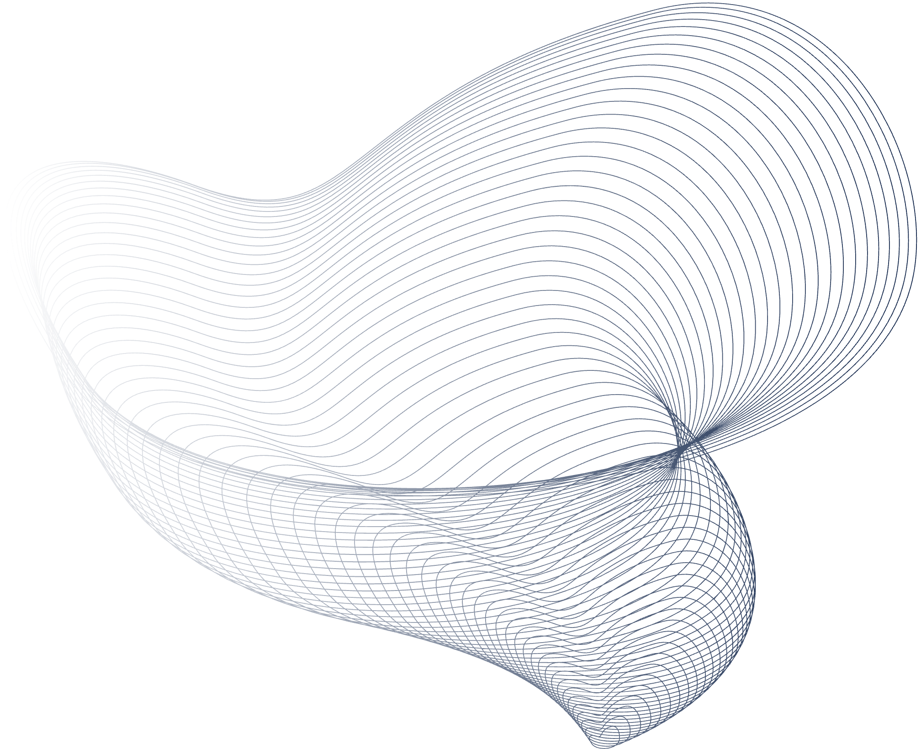
HackTrix’24
Team Name: Barca
Members Name: Mayank Mukherjee, Anshuman Singh, Nikhil Rajput, Mayank

Slide 2
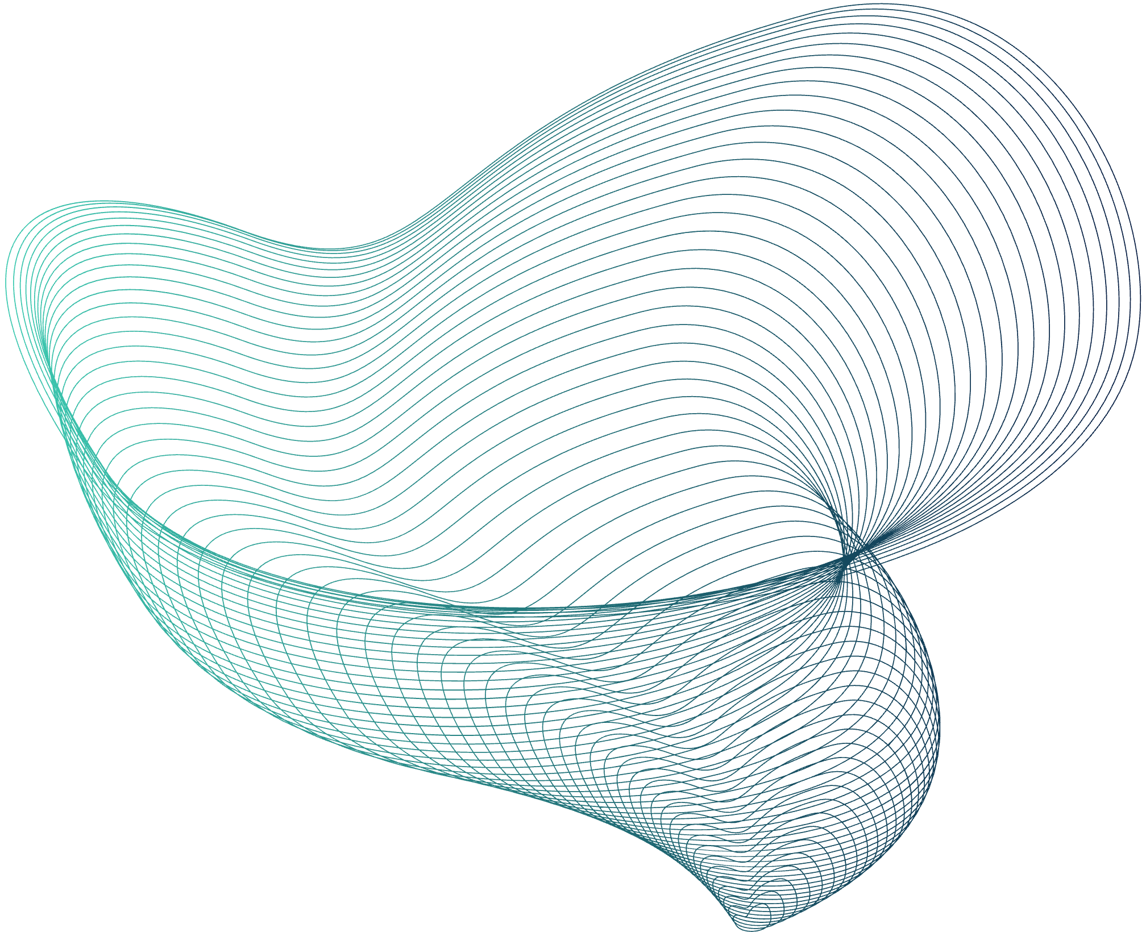
Introduction
Project Overview: Our project focuses on building a Machine-Learning Model, on Brain MRI-scan dataset and using DEEP Learning to build a model which provides accurate prediction of Alzheimer’s disease. For our novel idea we have trained with an unbalanced dataset and used SMOTE+ENN algorithm to achieve the same accuracy as modern-day models which use a balanced dataset.
…..

Slide 3
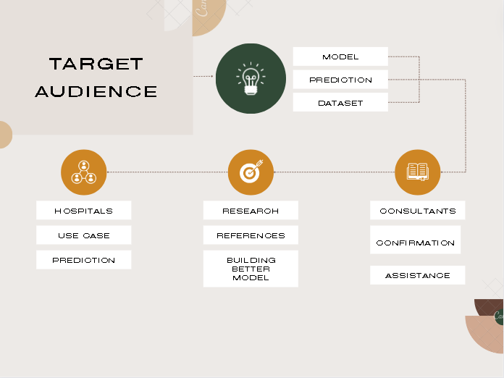
Target Users and market selection
Target Users: Healthcare Professionals, Research Scholars, Medical Institutions, etc.
Our Model targets users who expertise in medical fields and their technological applications. These include healthcare professionals, Research Scholars and other healthcare consultants who need a 2nd opinion or confirmation (Kind of like a preliminary test) .

Slide 4
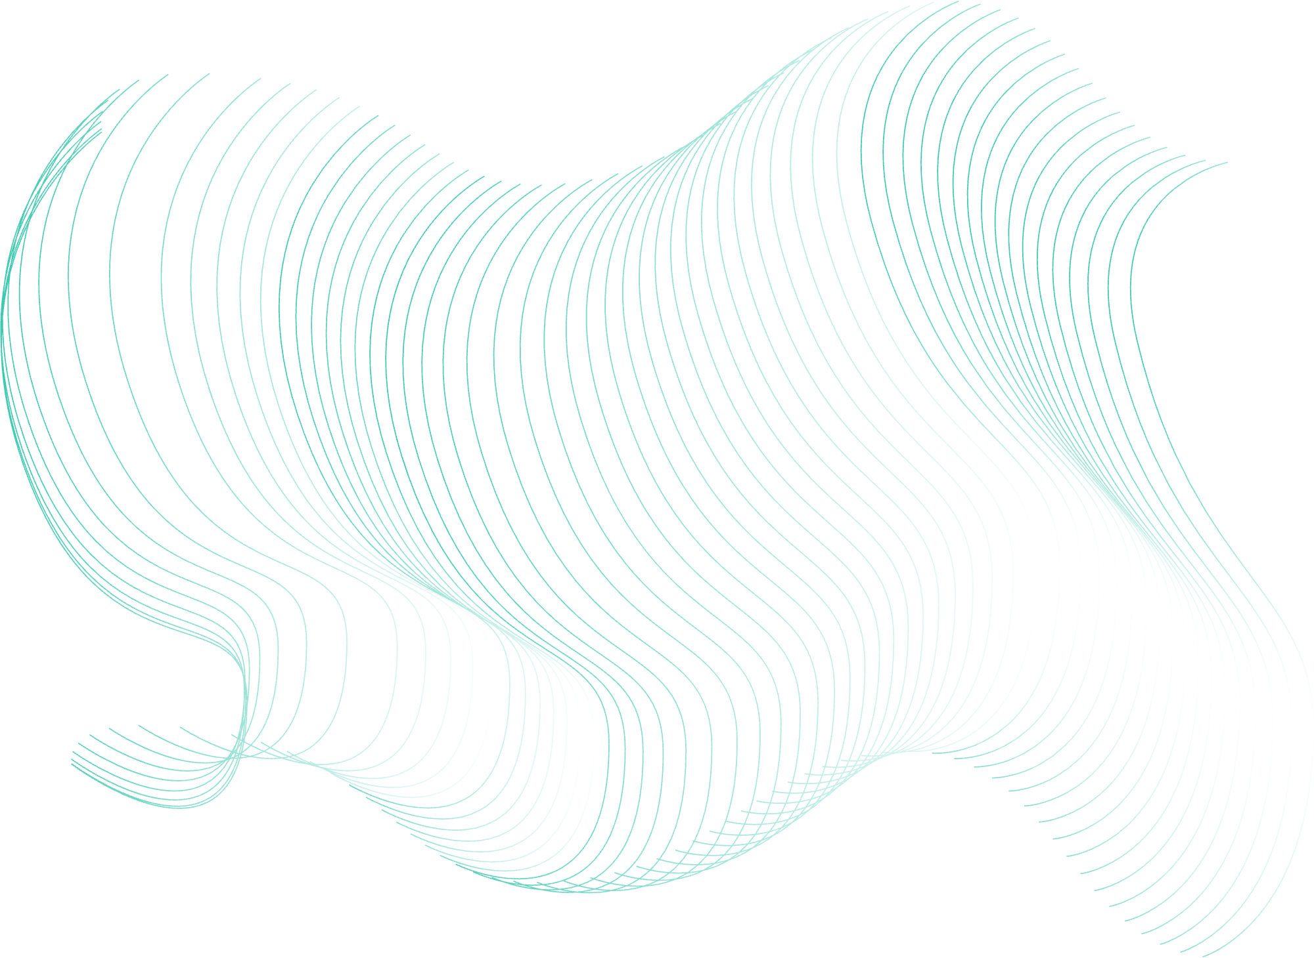
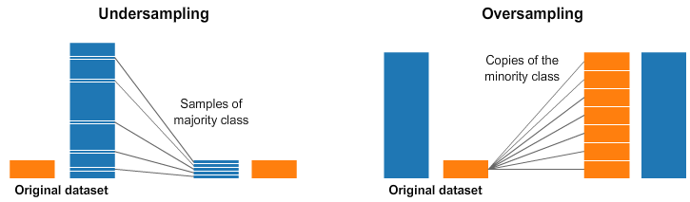
Problems
Building a Machine-Learning model revolves around having a vast dataset. Since there’s no such alternative, our model focuses on working with an unbalanced Dataset. This removes limitation risen at the time of data collection.
Unbalanced Dataset:
Unbalanced dataset has unequal class distribution, affecting model performance by favoring majority class.

Slide 5
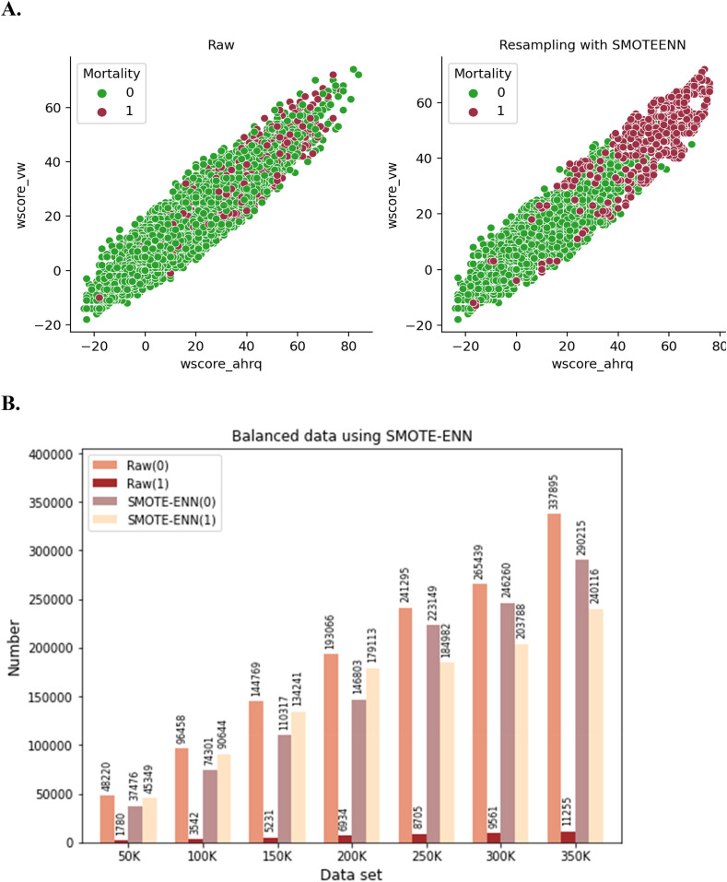
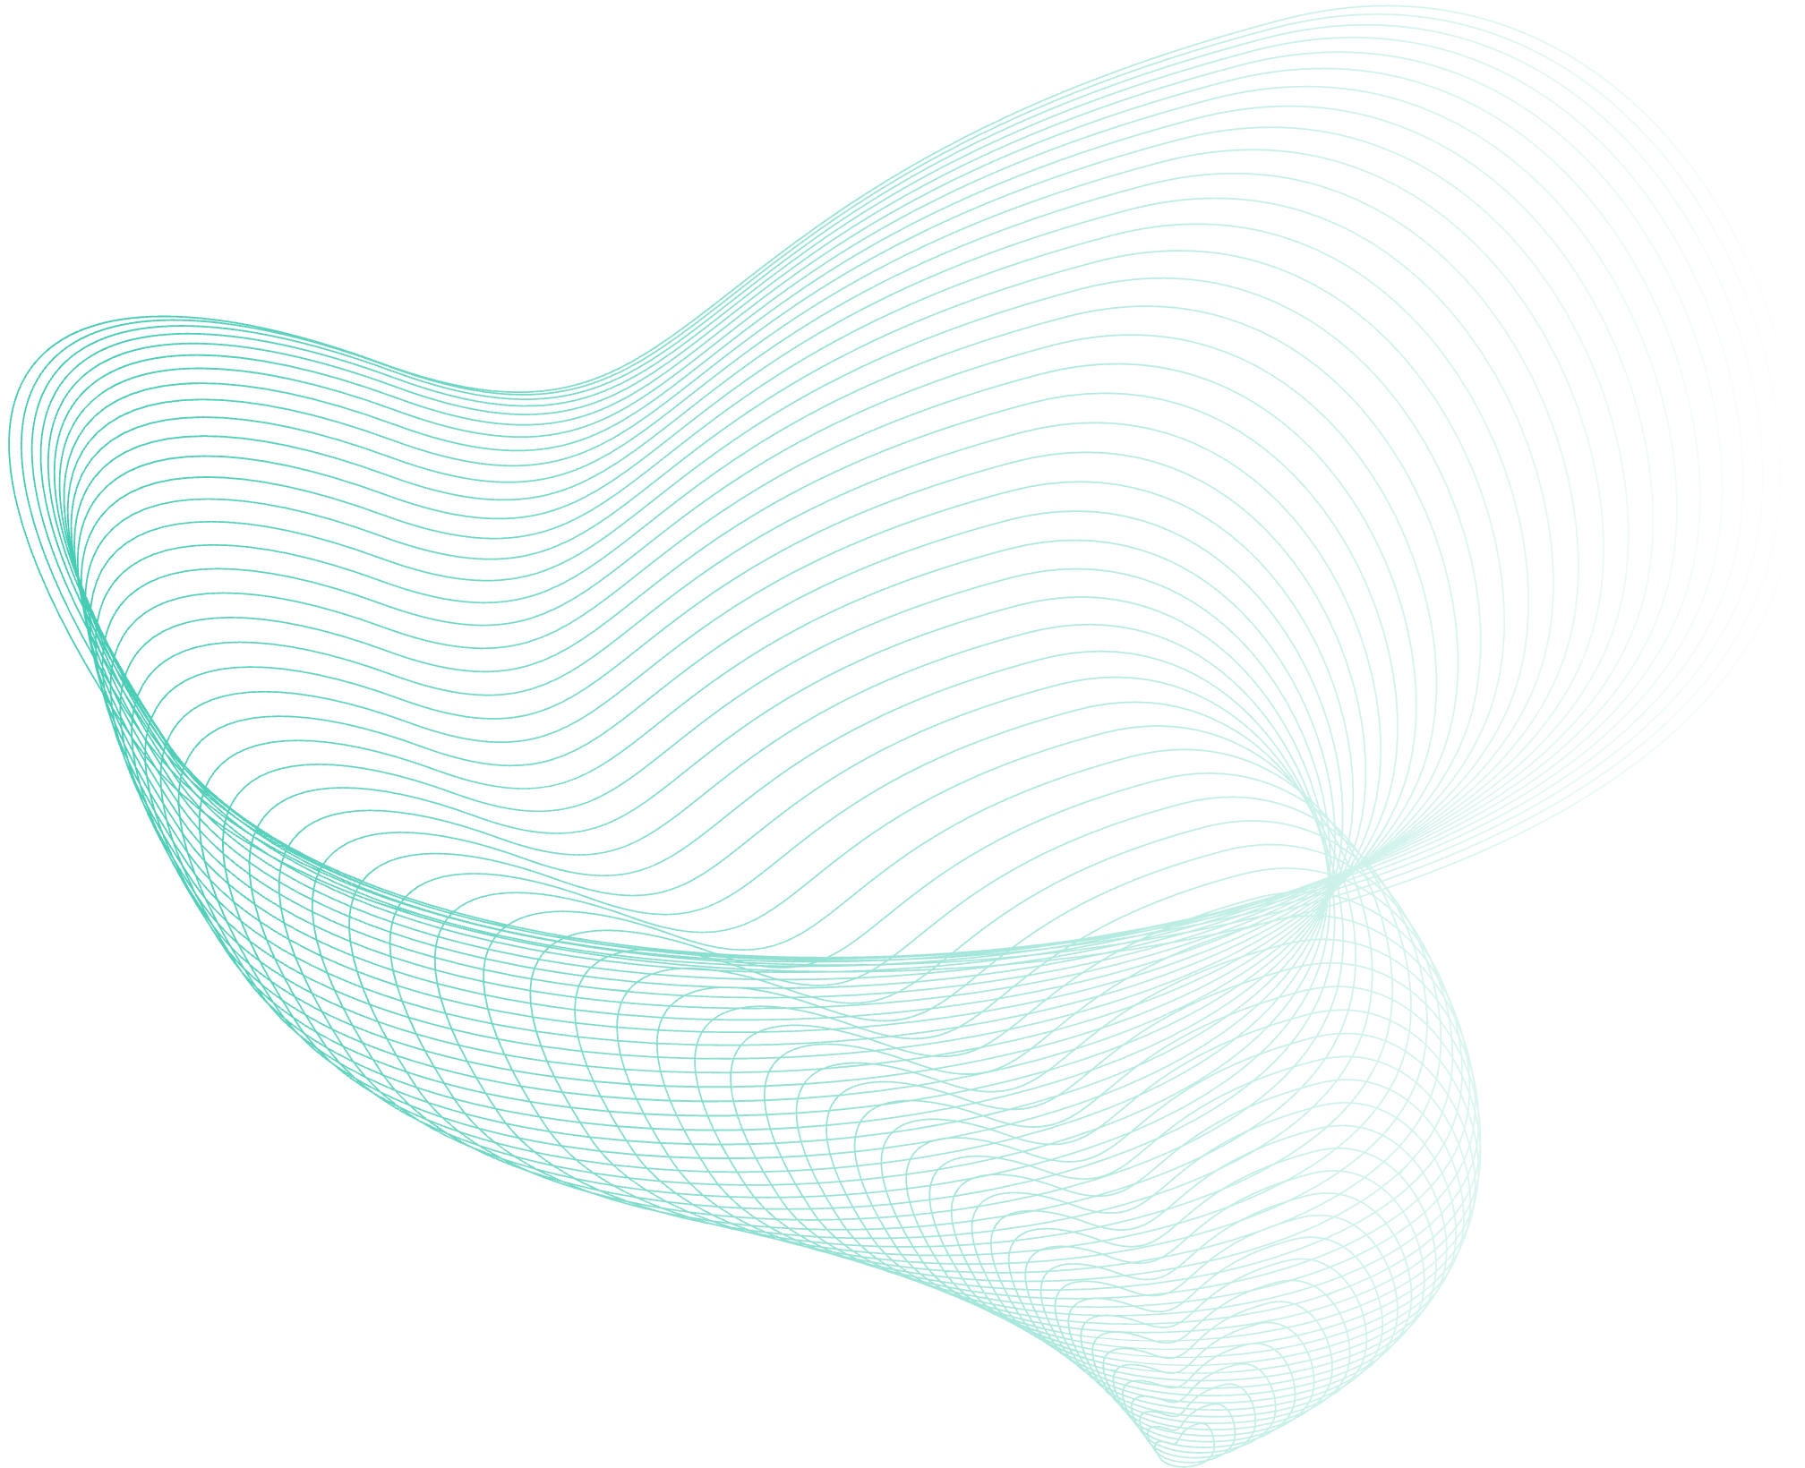
Proposed solution
(SMOTE+ENN algorithm, VGG16,
Grad-Cam visualization.)
Solution 2
Solution
In the presentation session, the background can be filled with information that is arranged systematically and effectively concerning an interesting topic to be used as material for discussion at the opening of the presentation session.
To remove dataset limitation, we used SMOTE+ENN algorithm.
We used VGG16 model to train the dataset and achieved an accuracy of more than 93%.
We also used GRAD_CAM visualizations to visualize working of our model at each stage of convolution.

Slide 6
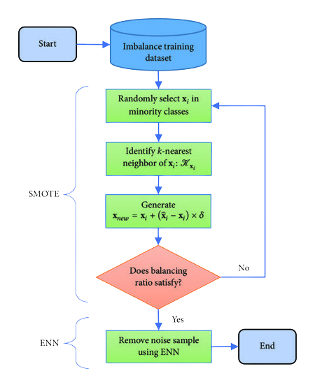
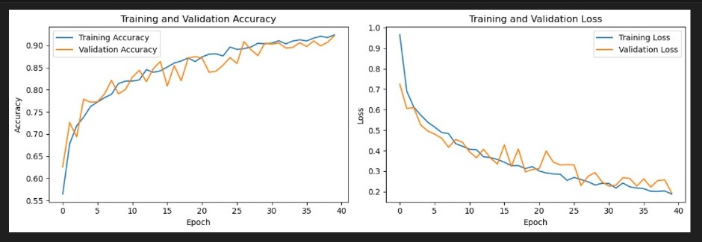
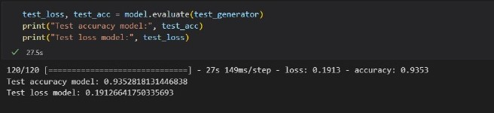
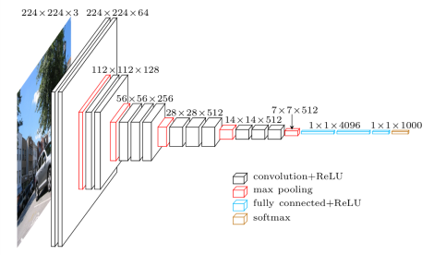
RESULTS AND DISCUSSION
PROPOSED METHODOLOGY
Solution 2
In the presentation session, the background can be filled with information that is arranged systematically and effectively concerning an interesting topic to be used as material for discussion at the opening of the presentation session.
SMOTE
NO
Our machine learning model achieved an accuracy of 93.5%.
YES
ENN

Slide 7
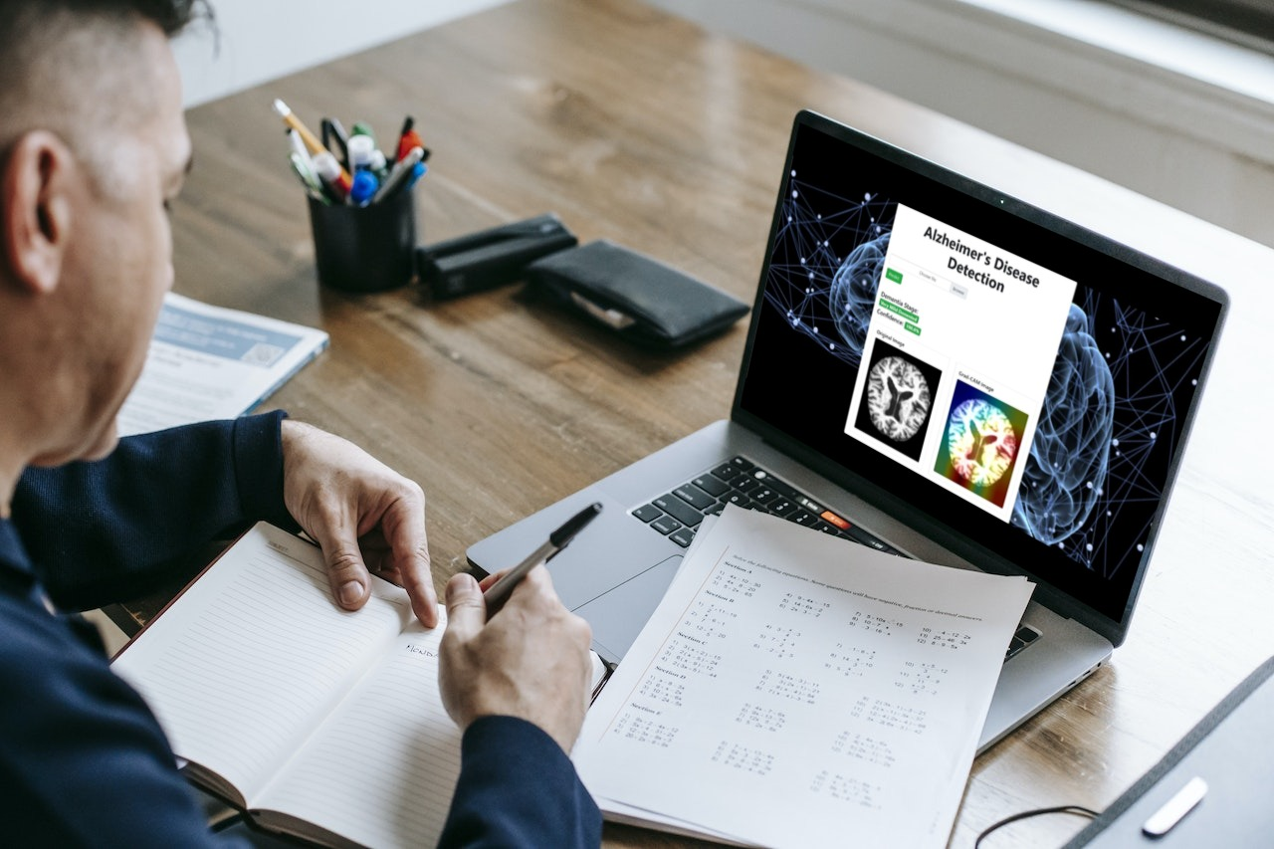
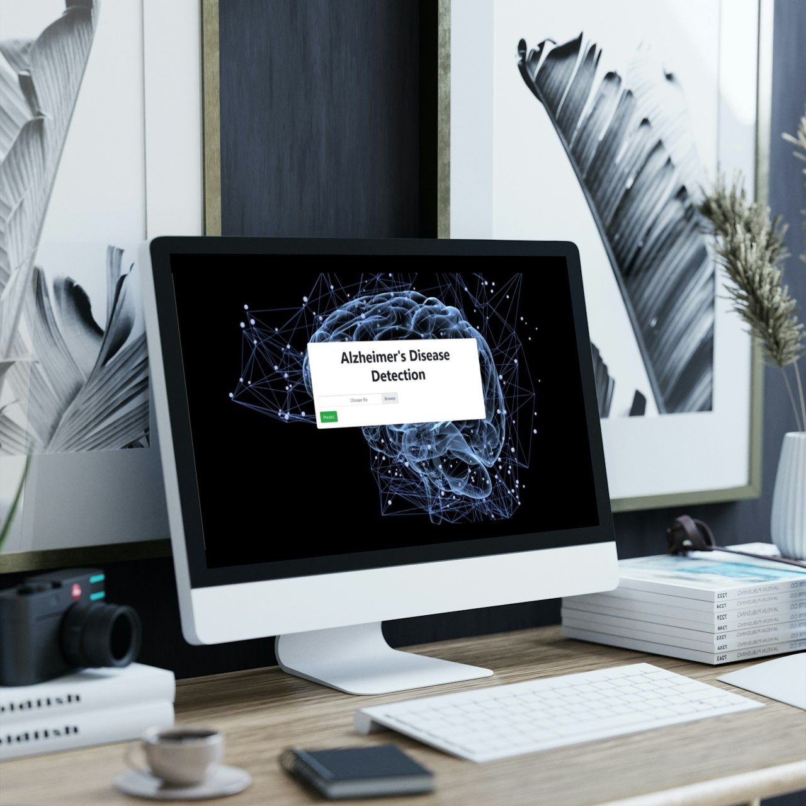
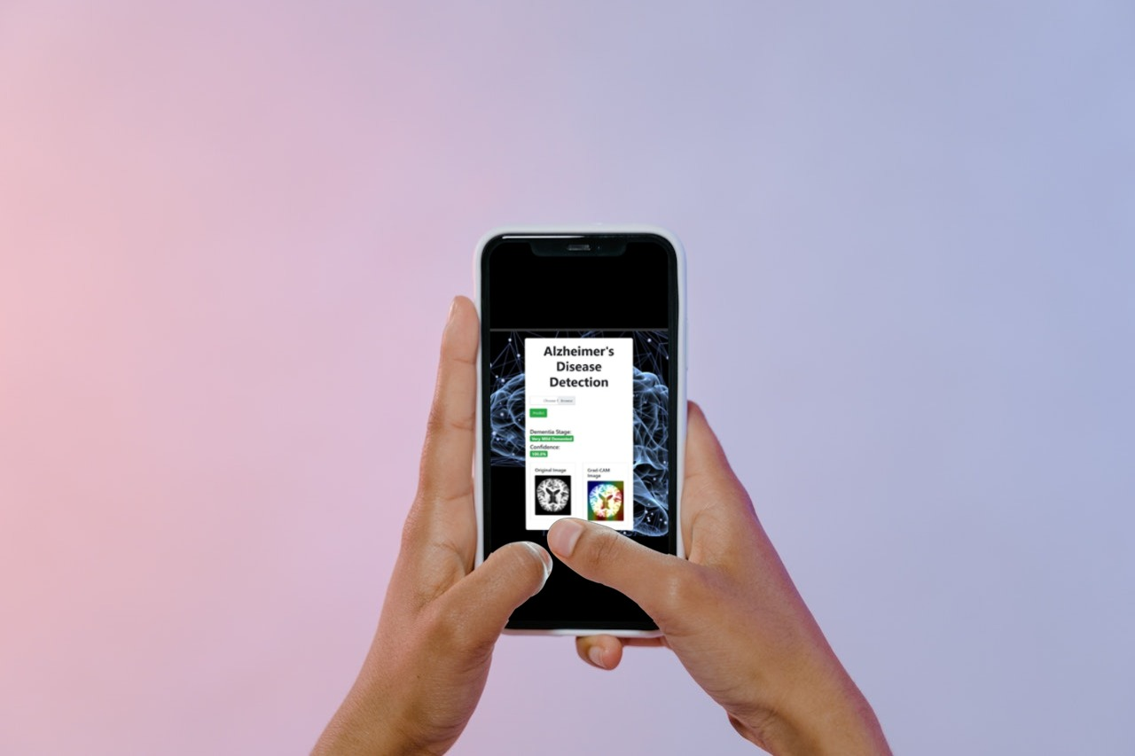
WEBSITE AND ANDROID-APP IMPLEMENTATION
Solution 2
In the presentation session, the background can be filled with information that is arranged systematically and effectively concerning an interesting topic to be used as material for discussion at the opening of the presentation session.

Slide 8
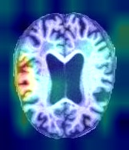
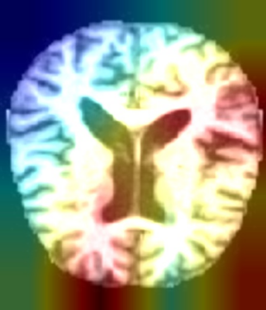
Solution 2
Challenges and Key Learning
(Imbalanced dataset, Oversampling, under-sampling, no verified dataset)
In the presentation session, the background can be filled with information that is arranged systematically and effectively concerning an interesting topic to be used as material for discussion at the opening of the presentation session.
Due to working with an unbalanced dataset, we needed to understand how the model is proceeding after every convolution layer, to determine whether the model is working or not.
We used GRAD_CAM to tackle this. We printed Gradient-mapped image after each convolution layer to determine Machine Learning activity.
OUTPUT
(AFTER 2ND CONVOLUTION LAYER)
INCREASED ACTIVITY
OUTPUT
(AFTER 10th CONVOLUTION LAYER)

Slide 9
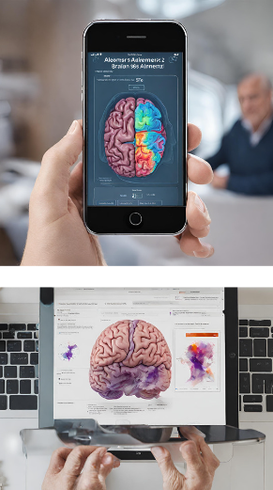

Future work
(An ML tool for healthcare image classification.)
Our prototype model classifies Alzheimer disease stages from Brain-MRI dataset. We want to upscale to other such domains in Medical Image Classification field, and build a consultant application, targeting all kinds of brain-activity related diseases.

Slide 10
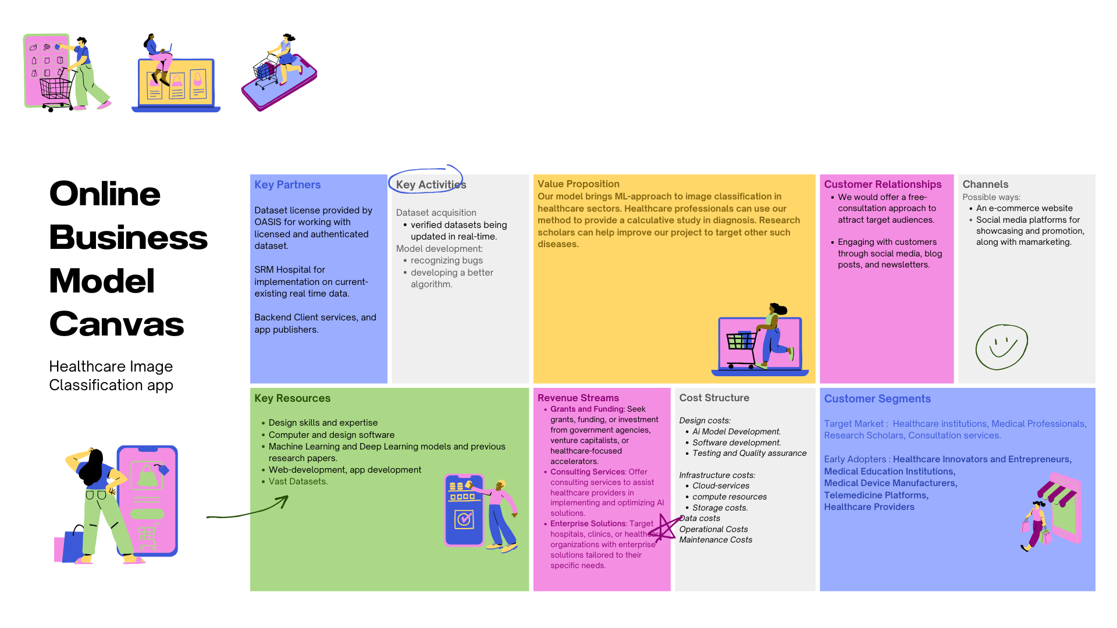
⁠Business Model and Monetization
PROPOSED BUSINESS MODEL FOR OUR
ML-MODEL BASED APPLICATION
(Business model canvas, Monetization, Estimated costs) (Potential features, plans for scaling)

Slide 11
Conclusion
Strategy 1
Thus, we developed a way to incorporate a Machine-Learning approach to the field of Healthcare image classification and built a model which classifies Brain-MRI image and delivers accurate prediction. We also found a way to work around an imbalanced dataset, which removes limitations around data collection and acquisition.
A Presentation By:
Team Barca Mayank Mukherjee Anshuman Singh Nikhil Rajput Mayank

